Slide 1
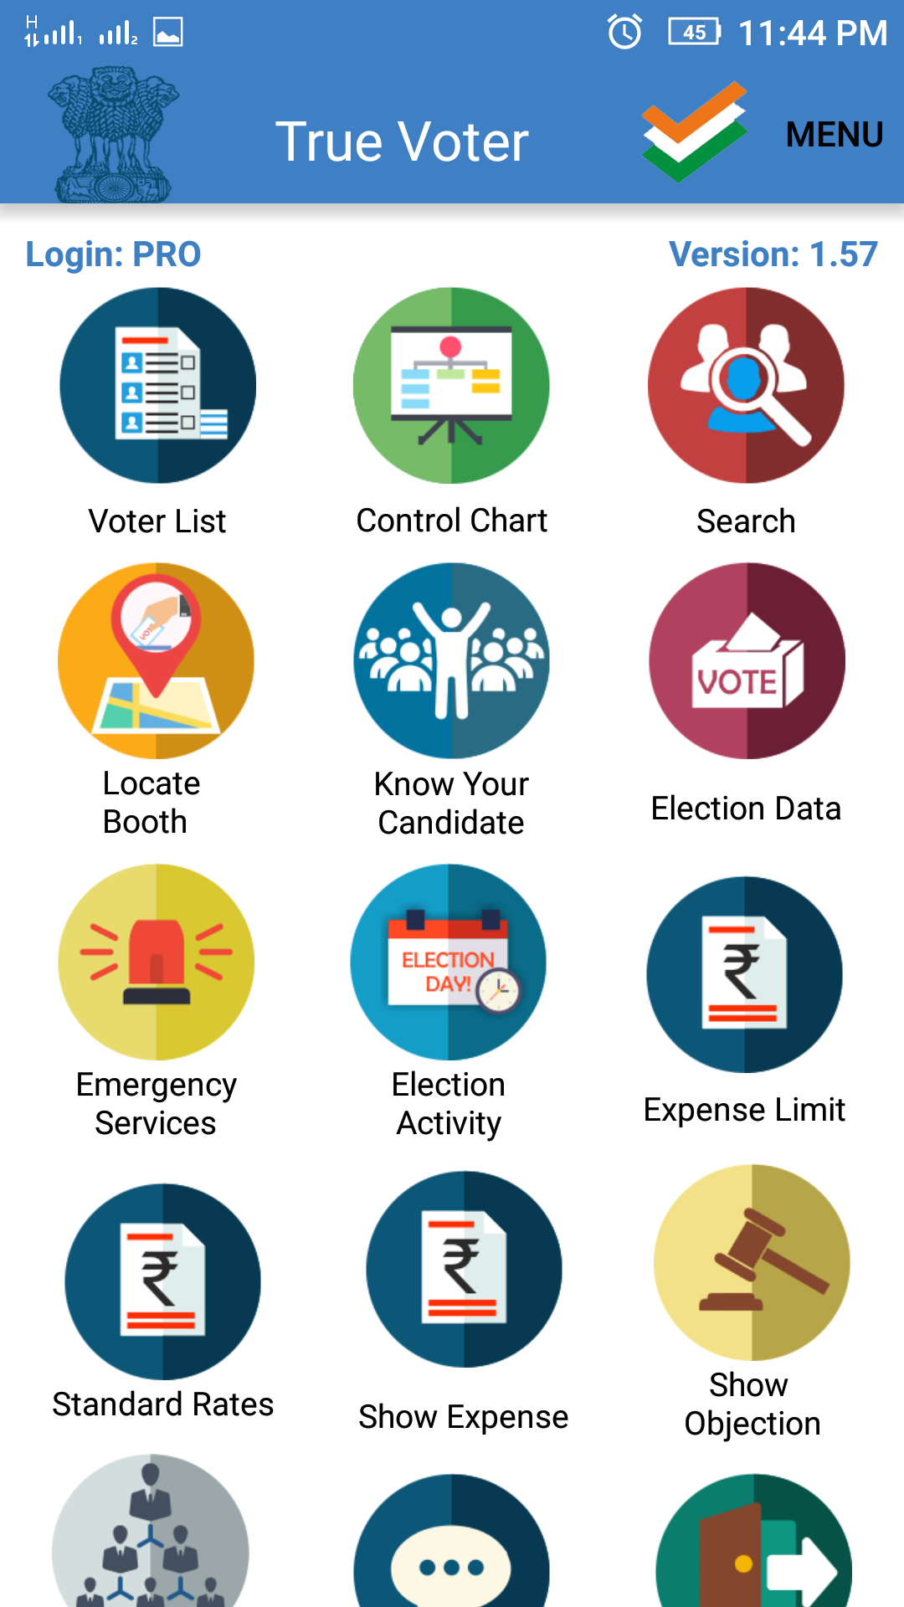
True Voter version 1.57
Emergency Services:-
This Function is available for all the roles of officer.
If any emergency will occured on the election booth at the time of election, on duty officer can request for help to his senior officer by using this functin.
Click on ‘Emergency Services’ on the home page.

Slide 2
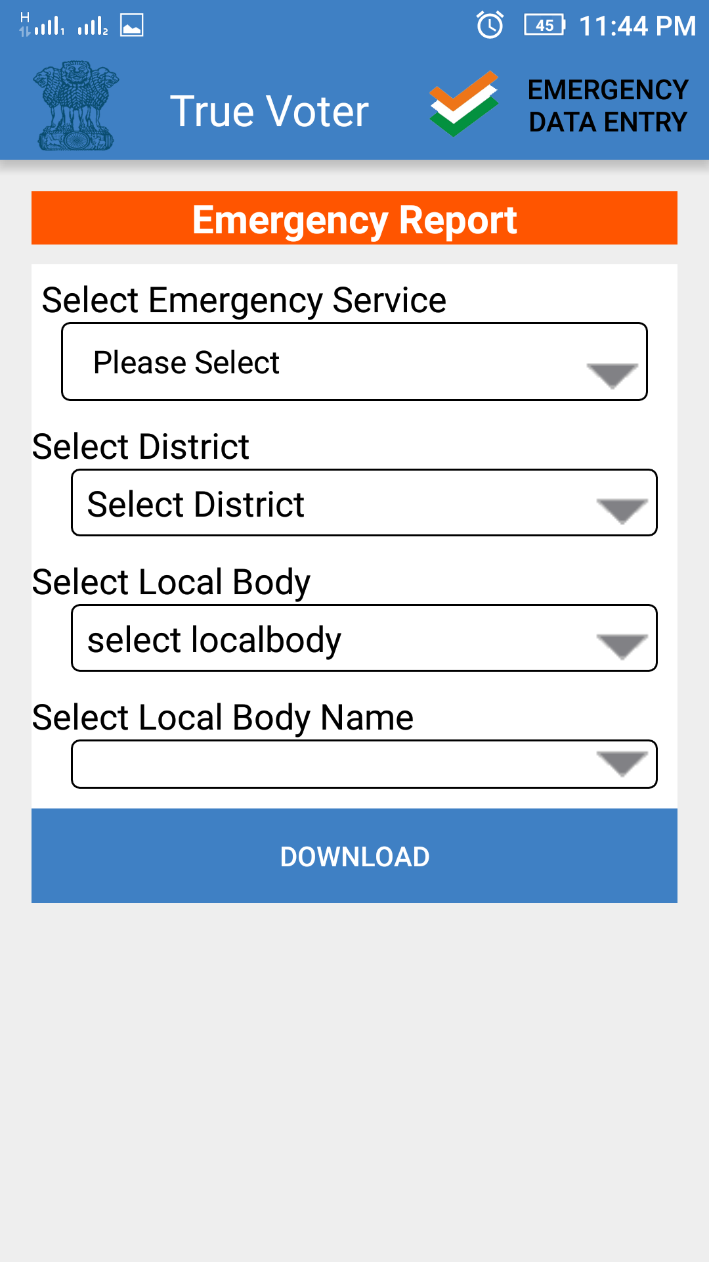
True Voter version 1.57
Emergency Report page will be displayed to the user.
To use emergency services function click on ‘Emergency Data Entry’ option on the header of screen.
On the next page user will be displayed the emergency services page, user have to insert the given details.

Slide 3
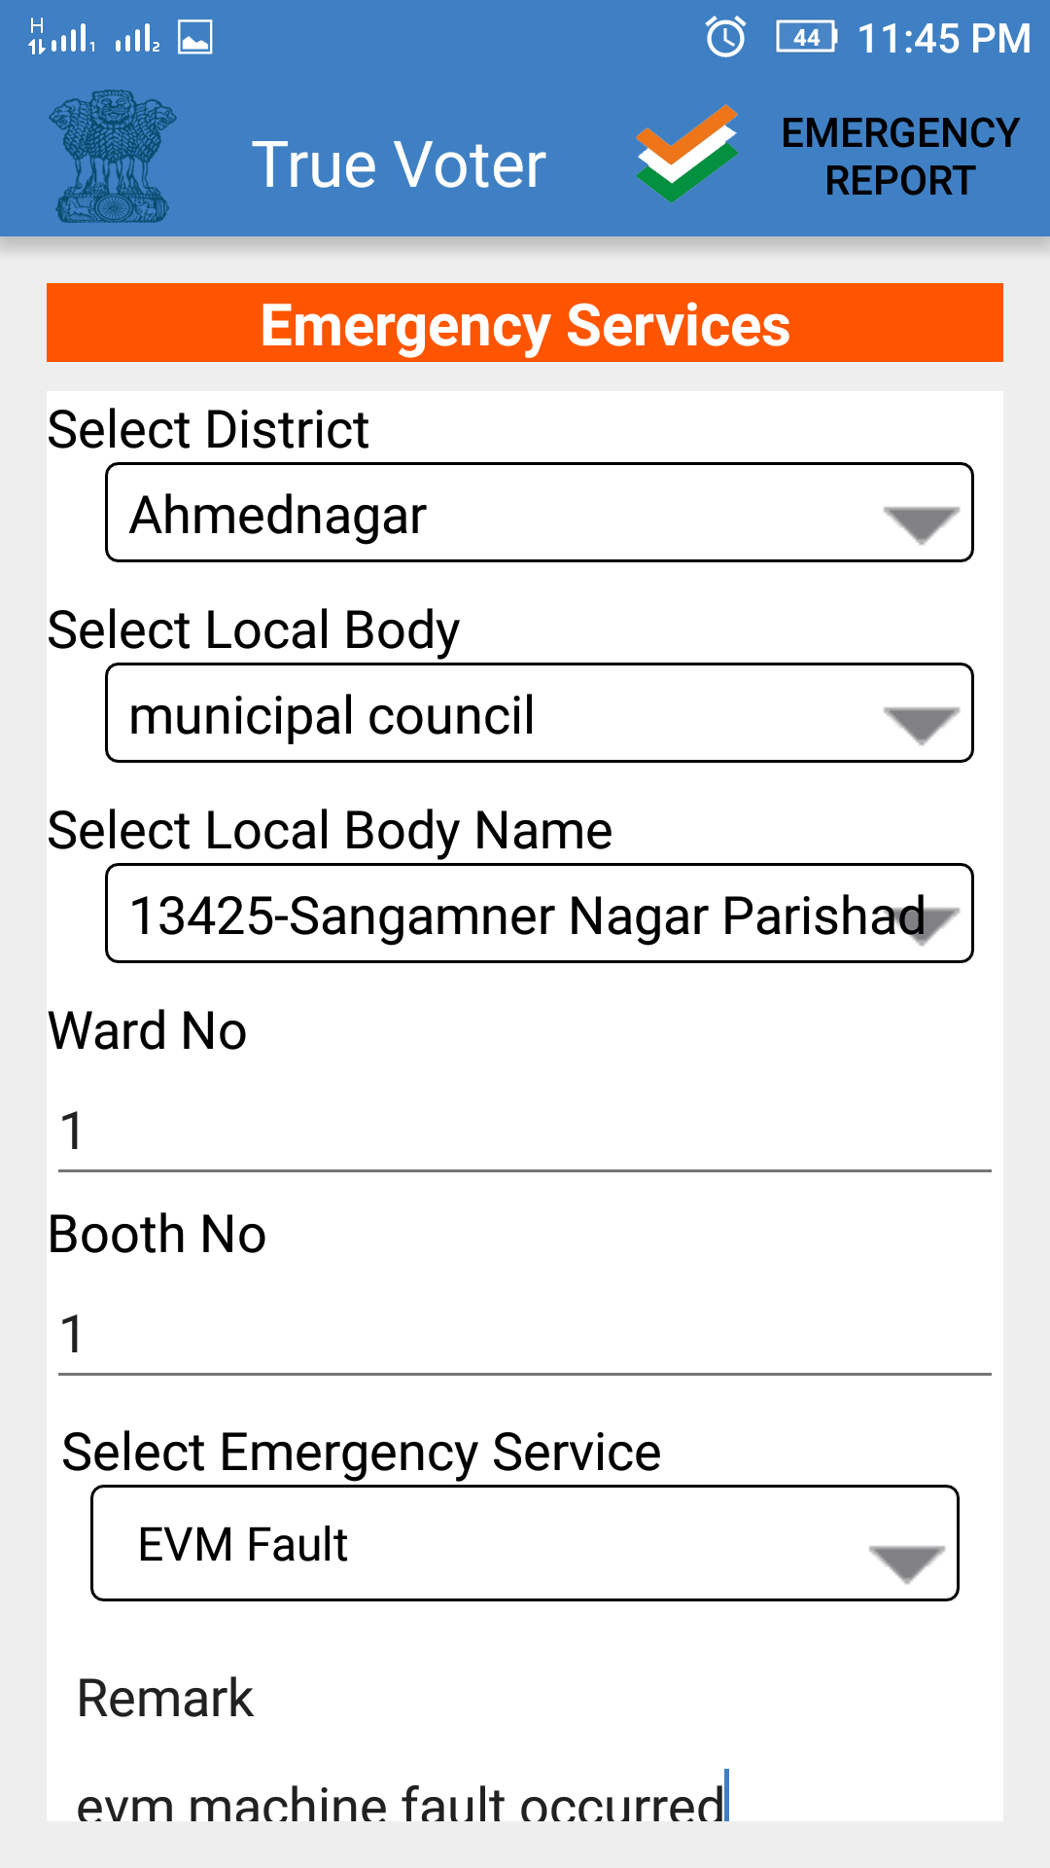
True Voter version 1.57
Select District form the list.
Select Local body type.
Select locala body name from list.
Click on ‘Select Emergency Services’ to view type of emergencies regarding election process.

Slide 4
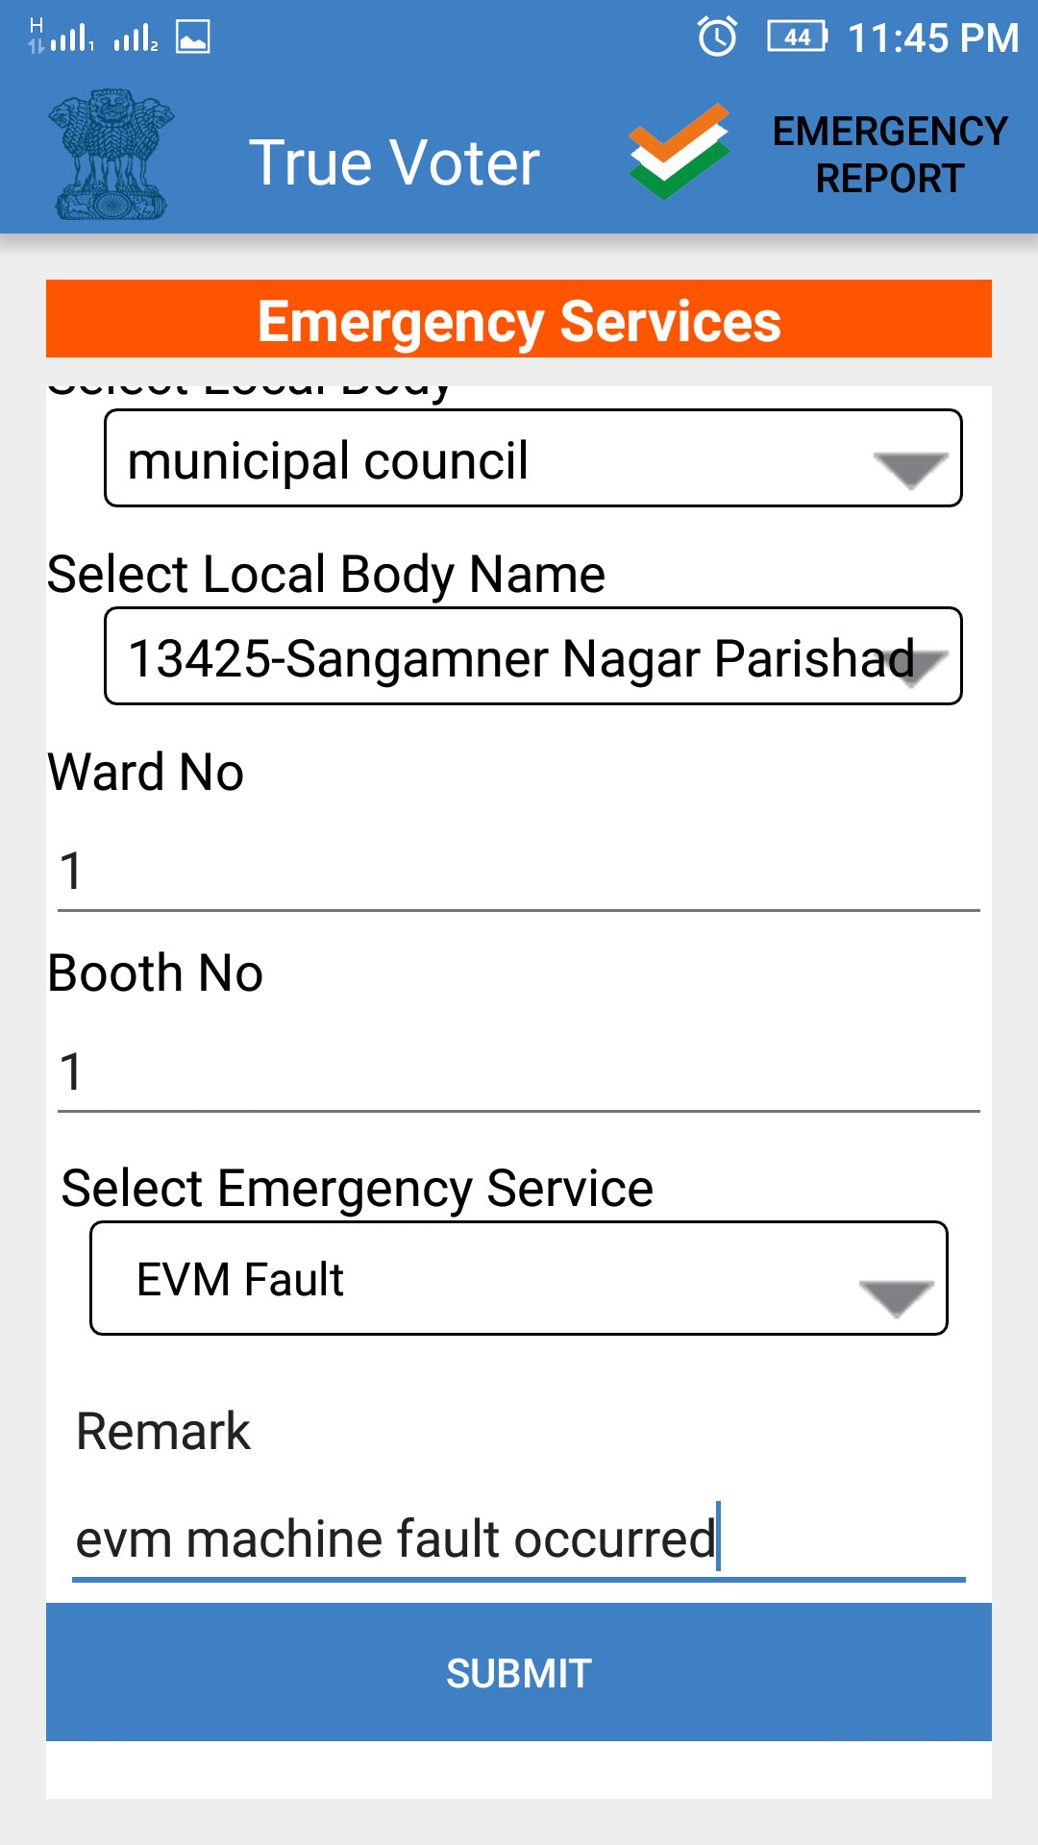
True Voter version 1.57
Select type of emergency regarding the election process from the given list.
Enter short Remark related to the emergency occured.
Click on ‘Submit’ button.
After submition of entry, the Senior officer of user will get a text message for the help.
To view the reoprt for the submitted entry click on ‘Emergency Report’ option on the heading.

Slide 5
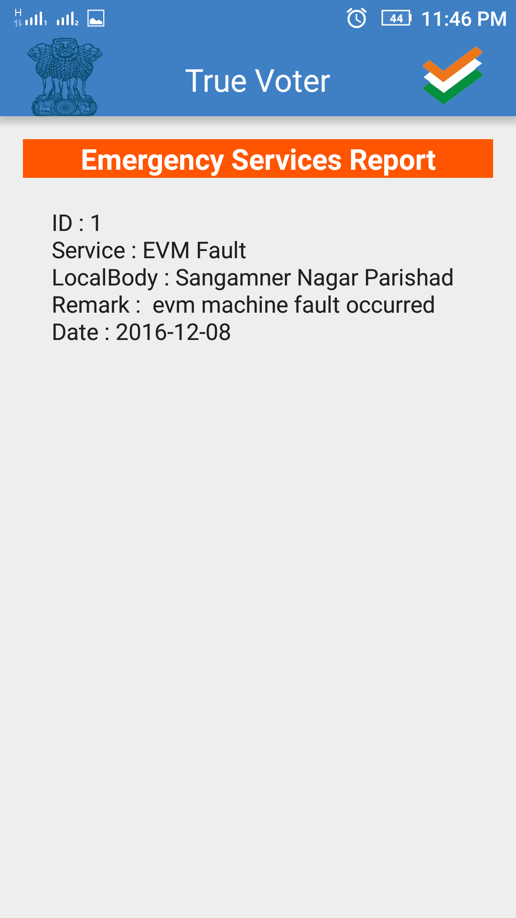
True Voter version 1.57
To view report for uses entry will be displayed as shown in the image.

Slide 6

True Voter version 1.57
To view report for Emergency Report click on ‘Emergency Report’ button on the home page.
User will be displayed the ‘Emergency Report’ page,
User have to enter given details to view report.

Slide 7
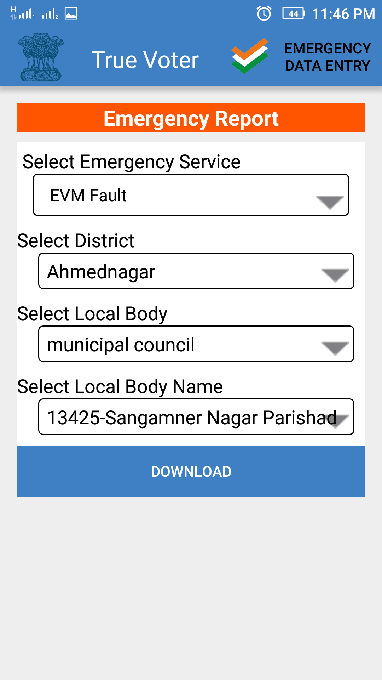
True Voter version 1.57
First select Emergency service for which user wants to view report.
Select district from given list,
Select local body type
Select local body name.
Click on ‘Download’ button to download the report.

Slide 8
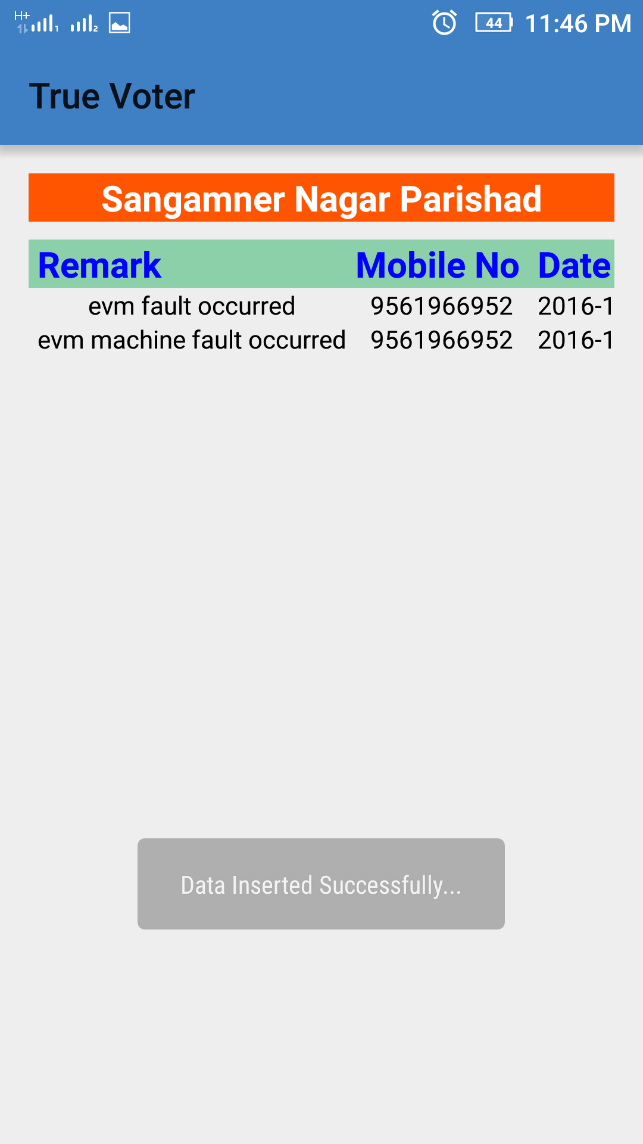
True Voter version 1.57
To view report for uses entry will be displayed as shown in the image.

